Slide 2
Azure Diagnostics Diagnosing and debugging live cloud applications
Paul Yuknewicz
@paulyuki99
Lead Product Manager
Visual Studio & Azure Tools
Andy Sterland
@andysterland
Lead Program Manager
Visual Studio Diagnostics
BRK2117

Slide 3
What this talk is about
Mantra of DevOps: move fast and break things
Fix things faster than you’re breaking them, and not moving in circles
Most of the time spent in finding the root cause

Slide 4
Why this is so hard
Frustrations with getting exceptions/logs/data
Issues caused by config, data, and scale
Acquiring and configuring the tools

Slide 5
Agenda
Getting started with app monitoring
Getting the data you need to root cause
Analyzing performance at scale

Slide 6



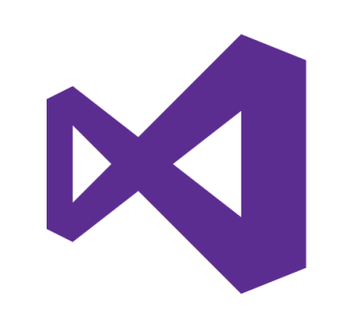
Products
Platforms
Application Insights
Application Map
Correlation
Analytics
Debugging
Profiling
Azure App Service
.NET / .NET Core
Snapshot Debugger
Azure Portal
Visual Studio Enterprise

Slide 7
Finding Issues in Production Getting Started

Slide 8
Step the first – Use a App Monitoring Solution
The first step to figuring out any problem with a deployed site is to have a monitoring solution
For that we’re going to be using App Insights

Slide 9
Setting up Application Insights The Easy Way

Slide 10
App Insights Portal

Slide 11
Setting up Application Insights Connected Service

Slide 12
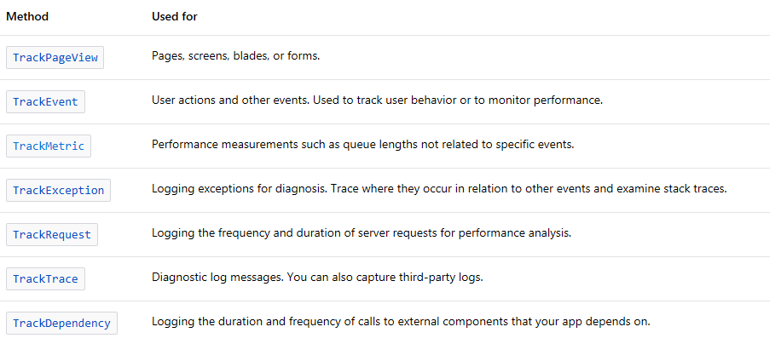
Log before you deploy
The first rule of making your app diagnosable in the cloud is to add logging
Incorporate thinking about logging in your code review process

Slide 13
Demo: TrackTrace

Slide 14
Demo: TrackMetric

Slide 15
Demo: TrackException

Slide 16
Demo: App Insights CodeLens

Slide 17
Logging With AppInsights
TrackTrace
Useful to diagnose issues
TrackMetric
Useful to track a quantifiable metric over time
Usefull to drive dashboards
TrackException
Consider logging as part of you’re code review process
Ok, we have all these things… Now what?

Slide 18
It’s broken!

Slide 19
Getting the data you need

Slide 20
Stories
Redeploying with
more logs
Impersonating the customer
Replicating production data

Slide 21


Slide 22
The Snapshot Debugger for Azure

Slide 23
Snapshots Intro
A complete picture of your application
Taking them doesn’t break your application
Capture the state of your application when exceptions happen
Not a video…
Only has the data for one point in time
Similar to dumps
Designed for Azure
Backed by role based azure security
Designed for apps that are at scale

Slide 24
Snapshot Debugger
Spectrum of features from exceptions in the portal to rich experiences in Visual Studio
Passive
Always on in the cloud
Collects snapshots when they happen
Snappoints and logpoints
On demand
Get the information you want

Slide 25
Demo: Exceptions in portal

Slide 26
Demo: Snapshots in portal

Slide 27
Demo: Snapshot Debugger in Visual Studio SnapPoints & LogPoints

Slide 28
Summary
Log, and log now!
App Insights is a powerful tool
The snapshot debugger collects rich diagnostic information passively and enables you to test out your hypothesis

Slide 29
Responsiveness & Scaling

Slide 30
Scenarios
Performance issues that affect every request
Entity Framework
CSHTML rendering
Blob store/http calls/etc.
Performance issues that happen at scale or infrequently
Resources overutilized
Garbage collection
Lock/resource contention
Load testing
Identify long durations in the dev-test phases
Verify changes before deploying to prod

Slide 31
Optimizing Performance
Deliver a great user experience: <500ms
Minimize cost of cloud resources
Overall minimize what code is doing over time:
Request:
Code waiting
0ms
Network
Process Inputs
Make DB or HTTP Call
Process Results
Return Results
1000 ms
Code executing on CPU
Second Request:
Done using CPU
Done using CPU
Resource Contention
0ms
Network
Process Inputs
Make DB or HTTP Call
Process Results
Return Results
1200 ms

Slide 32
Application Insights Profiler
Helps you see what code is doing over time
Captures data from production automatically
Samples 2 minutes/hour
Capture all requests that happen during that time
Data is stored for 5 days
Segments results into typical vs. long tail (median, 95th)
Announcing today: On demand profiling
Start the profiler on demand for two minutes
Works well with Load Tests
Works well with Live Metrics

Slide 33
Demo: Application Insights Profiler

Slide 34
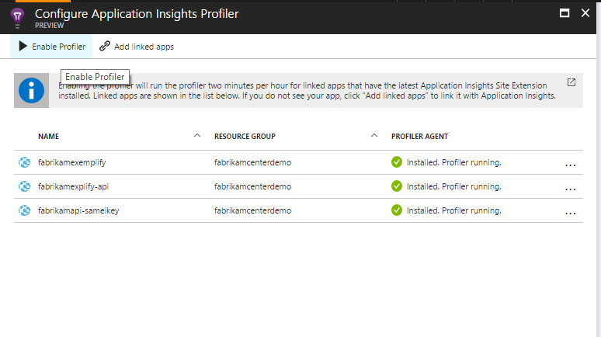
Enable Profiler from Performance Blade
Requirements:
.NET Framework 4.6
.NET Core on Windows
GA for Azure App Service
Preview Available for Compute (VMs, Service Fabric, Cloud Services)

Slide 35
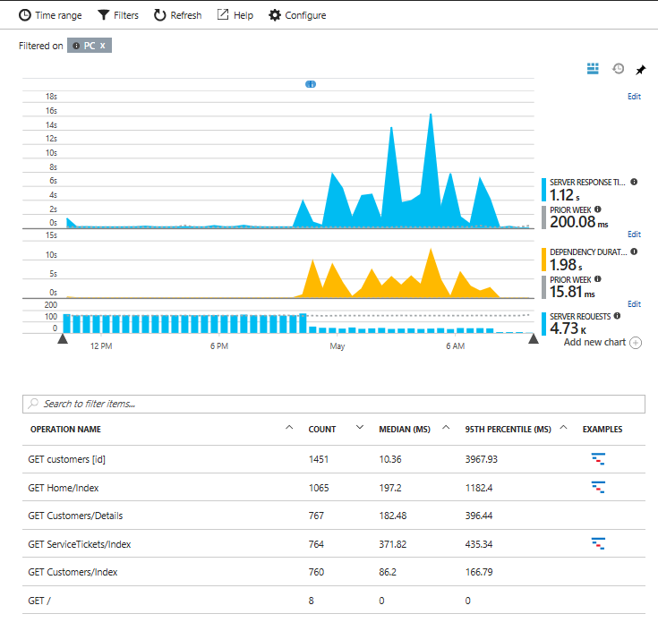
Prioritize Operations by Looking at Percentiles

Slide 36
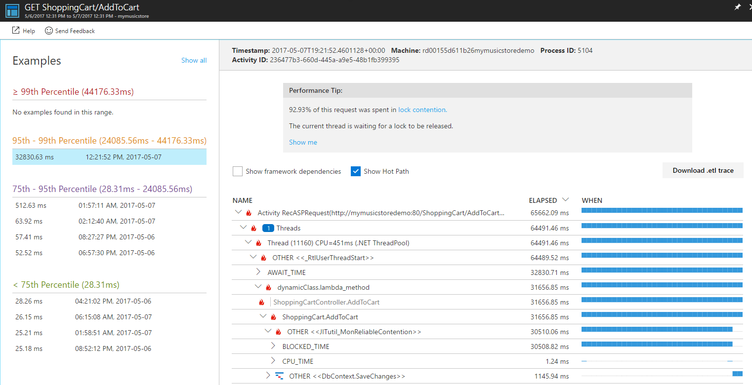
Drill Into Example Requests

Slide 37
Summary
The profiler collects slow requests automatically, and also on demand

Slide 38
Wrap up

Slide 39
Summary
App Insights, Azure, .NET and Visual Studio helps you solve issues with your services fast!

Slide 40
Call to action
Try out these Azure diagnostics tools:
https://docs.microsoft.com/en-us/azure/application-insights/
aka.ms/aisnapshotdebugger
aka.ms/aiprofiler
aka.ms/snappoint
Come see us at the booths either in the Azure area or the VS diagnostics booth
We need you!
Send us feedback
Take part in research & dogfooding Sign up at: https://aka.ms/tools/dogfood
GO HERE!

Slide 41
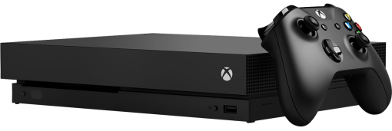
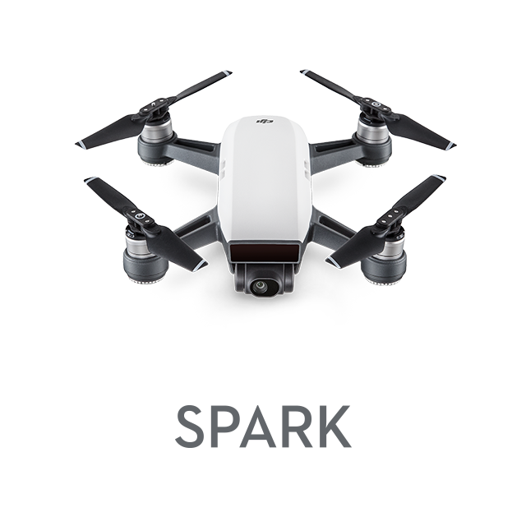

Daily Prizes
Xbox One X
DJI Spark Drone
Starbucks gift cards
Complete your evaluations to win prizes!
Be eligible to win! Make sure you are scanned into your session and complete your session eval to be eligible to win.
Seven winners each day! Winners will be notified via email.
Pick up your prize before leaving!
Prizes can be claimed at the info counter located on WSCC level 4, Galleria level.
Monday: pick up 2:15pm–6:30pm.
Tuesday: pick up 7:00am–6:00pm.
Wednesday: pick up 7:00am–5:30pm.
Please contact build@eventcore.com for more information

